Slide 1
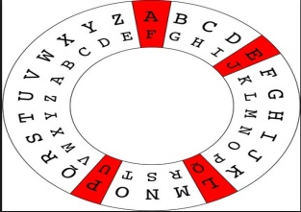

Symmetric Block Ciphers
Triple DES
BlowFish
IDEA
RC5

Slide 2
Triple DES
Shortcoming of DES is that it uses 56 bit key which means key space is relatively small. To overcome this, we run DES multiple times each using different key.
The speed of exhaustive key searches against DES after 1990 began to cause discomfort amongst
users of DES. However, users did not want to replace DES as it takes an enormous amount of time and money to change encryption algorithms that are widely adopted and embedded in large
Security architectures.
Incidentally, there are two variants of Triple DES known as
3-key Triple DES (3TDES)
2-key Triple DES (2TDES).

Slide 3
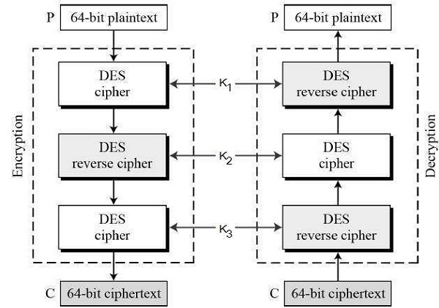
3-KEY Triple DES
Before using 3TDES, user first generate and distribute a 3TDES key K, which consists of three
different DES keys K1, K2 and K3. This means that the actual 3TDES key has length 3×56 = 168
bits.

Slide 4
The encryption-decryption process is as follows −
Encrypt the plaintext blocks using single DES with key K1.
Now decrypt the output of step 1 using single DES with key K2.
Finally, encrypt the output of step 2 using single DES with key K3.
The output of step 3 is the ciphertext.
Decryption of a ciphertext is a reverse process. User first decrypt using K3, then encrypt with
K2, and finally decrypt with K1.

Slide 5
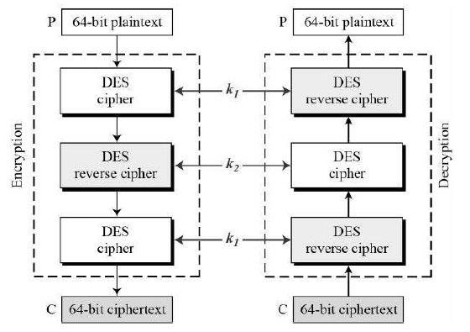
2-KEY Triple DES
Second variant of Triple DES 2TDES is identical to 3TDES except that K3is replaced by K1. In other
words, user encrypt plaintext blocks with key K1, then decrypt with key K2, and finally encrypt with
K1 again. Therefore, 2TDES has a key length of 112 bits.
IT does twice what DES normally does only once.

Slide 6
BLOWFISH
Blowfish was developed in 1993 by Bruce Schneier.
Blowfish is an encryption method that is a very strong weapon against hackers and cyber-criminals. Used in a wide array of products, including
some secure E-mail encryption tools,
backup software,
password management tools.
Blowfish is an encryption algorithm that can be used as a replacement for the DES or IDEA algorithms.
It is a symmetric (that is, a secret or private key) block cipher that uses a variable-length key, from
32 bits to 448 bits, making it useful for both domestic and exportable use.

Slide 7
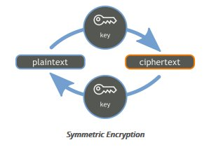
Easy to implement, High execution Speed.
It is a symmetric block cipher. What does that mean? Well, it is symmetric
because the same key is used for both encryption and decryption; the key has to be kept secret from all others except the sender and receiver. This image shows a high-level example of the process of symmetric encryption.

Slide 8
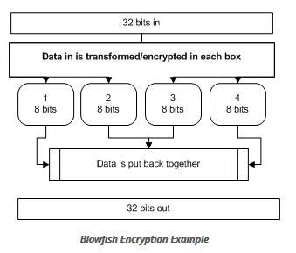
Blowfish uses a unique form of key generation. The second part of the Blowfish
routine is a key expansion that converts a single key of up to 448 bits into a table of subkeys that is 4168 bytes in size. The creation of subkeys further increases security,
because a hacker would have to crack more than just the original key.
32 bits enter the algorithm, they're split into
four 8-bit boxes, transformed/encrypted, then
put back together. Blowfish runs through this
routine sixteen times.

Slide 9
Strength of Blowfish
Blowfish is an incredibly fast cipher (encryption tool) that has a relatively simple
structure and is very effective.
Blowfish generates a really large key and this alone is a huge benefit to security.
With the increase in speed of computer processing, Blowfish is able to create a
much longer key so that it is much more difficult to try to hack the key value.
And the way that it generates sub-keys means that each pair of sub-keys changes slightly as they are generated. This prevents attackers from figuring out how the
sub-keys were generated, and then gaining access to all the other known keys.

Slide 10
IDEA (International Data Encryption Algorithm)
Originally called Improved Proposed Encryption Standard (IPES)
In cryptography, the International Data Encryption Algorithm (IDEA),is a symmetric-key
block cipher designed by James Massey of ETH Zurich and was first described in 1991.
The algorithm was intended as a replacement for the Data Encryption Standard (DES).
Key Size - 128 bits.
Block Size- 64 bits.
Round – 8
Complex functions replace S boxes.
Highly Resistant to cryptanalysis.
Used in PGP (Pretty Good Privacy)

Slide 11
RC5
RC stands for "Rivest Cipher", or alternatively, "Ron's Code"
Designed by Ronald Rivest in 1994.
RC5 is a symmetric-key block cipher notable for its simplicity.
RC5 has a variable block size (32, 64 or 128 bits),
key size (0 to 2040 bits) and
Number of rounds (0 to 255).
The original suggested choice of parameters were a block size of 64 bits, a 128-bit key and 12 rounds.

